Slide 1

Change detection on different land covers
MINI PROJECT :
Student name: Yash Kumar Kaushik
University ID: 2019245
Course: B-tech(CSE)
Mentor: Mr. Hemant Pokhriya

Slide 2
INTRODUCTION :
PROBLEM STATEMENT
Due to Urbanization and industrial development, there has been a vast change in Land use over the past few centuries, leading to the degradation of suitable and sustainable environments.
Few cities in the world have established planned layouts for urban distributions. Over time, low-density built-up regions become high-density and later extremely dense regions because of the increasing land demand due to changes in the desirability of the communities.
Over the last 140 years, India has seen drastic shifts in LULC, including a reduction in the forest, a change in cropland, and an increase in urbanization). This practice continued till the 1960s, when, for the first time, the ‘Green Revolution’ limited itself to increasing crop production, irrigation, and the use of fertilizer and pesticides.
Fact: UN estimates show that 60 percent of the world’s rural villages will be covered by large cities in 2050.
due to unplanned urban growth caused by a lack of planning and development and India is a nation with 1.38 billion(1,407,563,842 2023 est.). There is a need for a land cover classification for the sustainability and effective use of the remaining land cover.

Slide 3
INTRODUCTION:
Land cover: Land cover refers to the physical characteristics of the earth’s surface distributed captured in the distribution of vegetation, water, soil, and other physical features.
Land use: Land use refers to the way in which the land has been used by humans and their habitats. Although land use is generally inferred based on the cover, yet both the terms land use and land cover being closely related are interchangeable.
Land use/cover and its dynamics are important factors that affect ecosystem conditions and functions. In the past 40 years, land use cover change dynamics have been considering changing the biogeochemical cycling leading to changes in surface atmospheric energy exchanges, carbon and water cycling, soil quality, biodiversity, the ability of biological systems to support human needs, and, ultimately the climate at all scales.

Slide 4
METHODOLOGY:
DATA SOURCES:
For the study, various spatial databases were developed to model the LULC and its urban growth using various parameters.
Parameters | Data source
LULC | USGS Landsat 5 and 8 using GEE
Digital Elevation Data | NASA SRTM Digital Elevation 30m using GEE
Spectral bands reflectance and collection | Sentinel-2 MSI: Multispectral Instrument using GEE
Sentinel-2: is a European wide-swath, high-resolution, multi-spectral imaging mission. The full mission specification of the twin satellites flying in the same orbit but phased at 180°, is designed to give a high revisit frequency of 5 days at the Equator.

Slide 5
METHODOLOGY:
GOOGLE EARTH ENGINE: GEE is a geospatial processing tool with a cloud-based platform for a wide-ranging environment study and interpretation. The GEE is a web-based Graphical User Interface (GUI) that provides access to a multi-petabyte catalog of RS imagery and other datasets through Google’s computational infrastructure. Earth Engine stores, more than thirty years of historical imagery and scientific datasets, updated and expanded daily. It organizes them and makes them available for public users, as well as, for commercial ones or administration systems.
LULC MAPPING: It is easier to do the LULC mapping/classification in the google earth engine since GEE makes it easier for us by specifying the different modes of operations by combining the data input.GEE makes it easier to collect the training data and helps us to train the classifier. The classifier performs supervised classification using Earth Engine’s standard Machine Learning (ML) algorithms. Classification and Regression Trees (CART), Random Forest (RF), Naive Bayes, and Support Vector Machine (SVM) are among the classifiers.

Slide 6
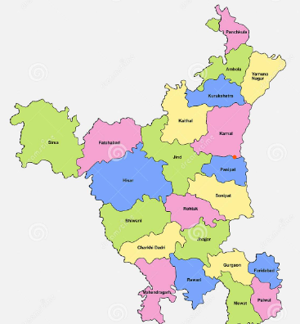
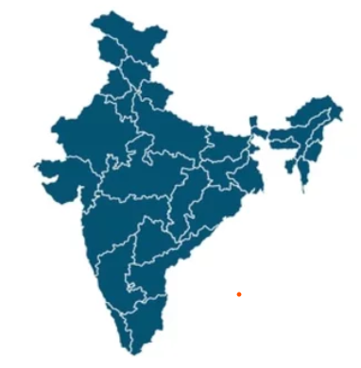
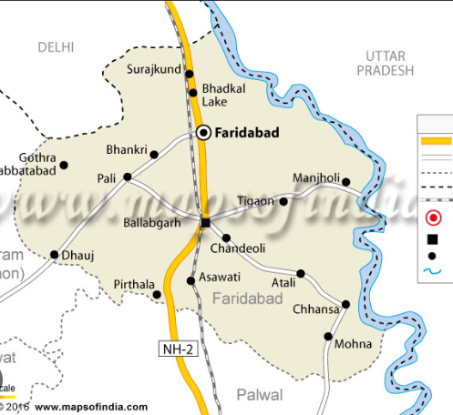
METHODOLOGY:
STUDY AREA: The study area for this research work is the Faridabad district of the Haryana state of INDIA. Faridabad District and Division lie between 28°10’50” N and 28°29’04” N latitude and between 77°06’49” E and 77°33’23” E longitude.

Slide 7
RESULT AND DISCUSSIONS:
We have completed the mini project with an 80%-90% accuracy assessment. There are some errors during the classification but those are because the LULC classification also needs an onsite visit since computers can’t do everything and the study area that we selected for this project is the Faridabad district of Haryana state.
The main goal of this study is to detect land usage and determine the spatial distributions of and changes in the land cover types in the study area we checked its water, vegetation, city, and other classes categorized under mainly three classes Water, vegetation, and non-vegetation.
Remote sensing is rapidly expanding due to new earth observation satellites, vast libraries of accessible data, and expanded computing capacity. GEE has been booming because it is a freely available cloud-based geospatial analysis and modeling tool that allow users to view, observe, and interpret geospatial data for many applications..

Slide 8
RESULT AND DISCUSSION
GEE was used to identify the LULC because it has a cloud platform, a user-friendly interface, and an effective scripting language, and it has a high degree of adaptability and flexibility. It is not easy to map LULC using single or even monthly composite imagery. Mosaicking, stacking, and filtering images to produce a satisfactory land cover map from remotely sensed images have become simple as GEE has evolved.
The use of ML algorithms in combination with geographic object-oriented analysis techniques is expanding rapidly for GEE, where it is an effective environment for creating multitemporal composite images and implementing complex image processing and classification processes in a simple way

Slide 9
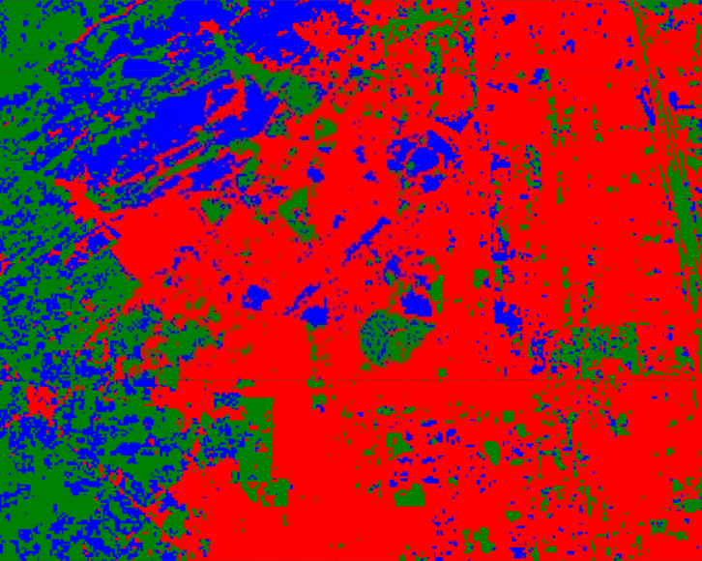
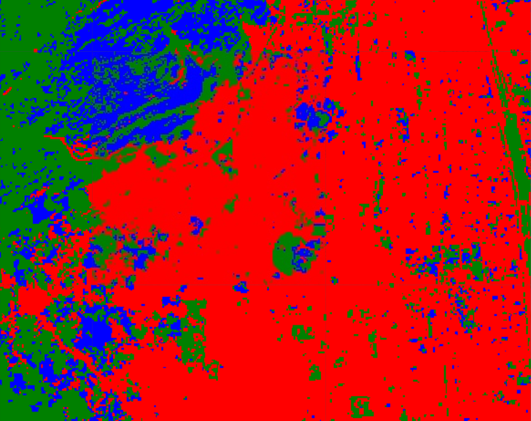
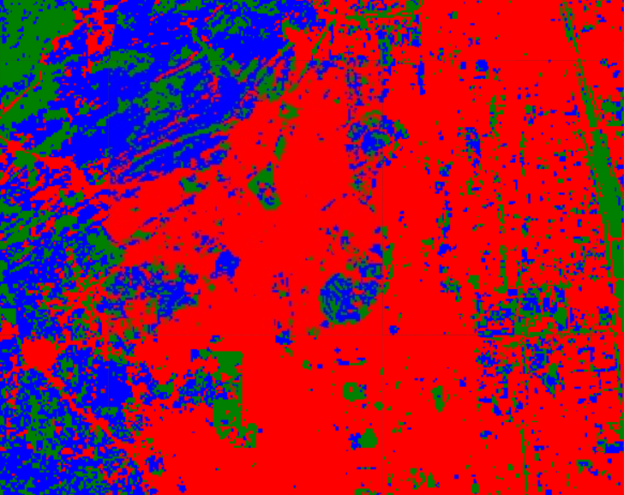
RESULT AND DISCUSSIONS:
2015
2017
2020

Slide 10
CONCLUSIONS:
Transition and rapid industrialization are major factors in development. The area of the forest class will continue to grow, but the agricultural class will decrease compared to other classes. The historical records of land cover change clarified the rate of encroachment of urban areas on some other land cover, with dispersed patches of urban growth classifying the urban sprawl in the metro city. The climatic parameters indirectly influence the changes. There are some errors in our study because of the lack of an onsite visit to confirm our analysis.
The future work regarding our study will be the prediction of the LAND USE LAND COVER change on our study area after a certain time period i.e. 2030 or 2050.
The results of this analysis can be adapted for city’s future development plans that city authorities, project planners, and other organizations can use in decision-making for LULC policies for sustainable development, resource management, and public planning.

